Slide 1
Machine Independent Assembler Features
Literal, Symbol, Expression

Slide 2
Literals
Motivation
  It is convenient if a programmer can write the value of a constant operand as a part of the instruction that uses it.
  This avoids having to define the constant elsewhere in the program and make up a label for it.
Such an operand is called a literal because the value is stated “literally” in the instruction.

Slide 3
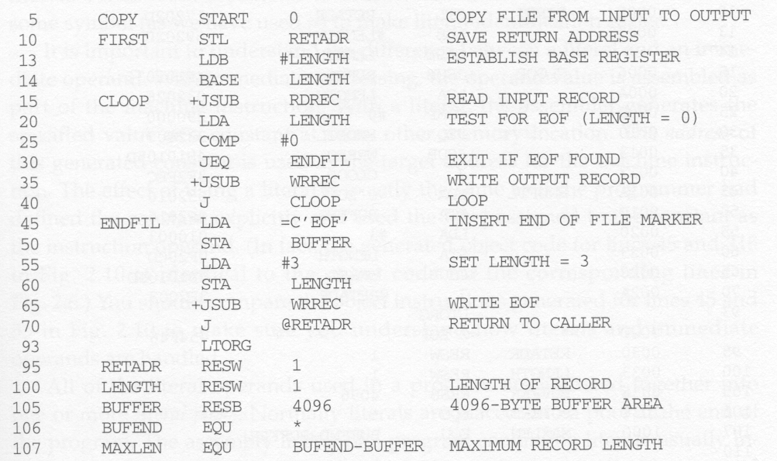
Literal Example (1)
Use = to represent a literal
Specifies a 3-byte operand whose value is character string EOF

Slide 4
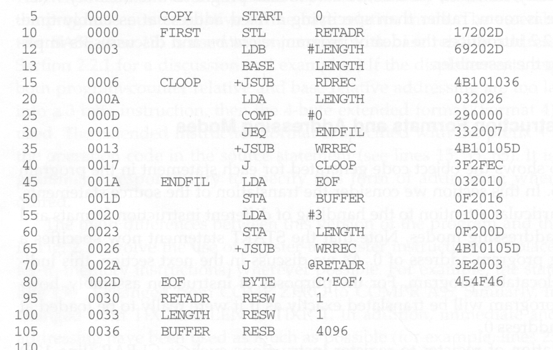
Original Program (1)

Slide 5
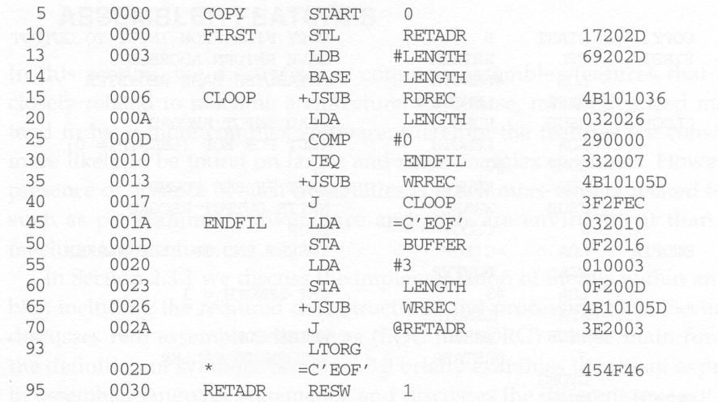
Literal Program (1)’s Object Code
Notice that the object code is the same as the previous one.

Slide 6
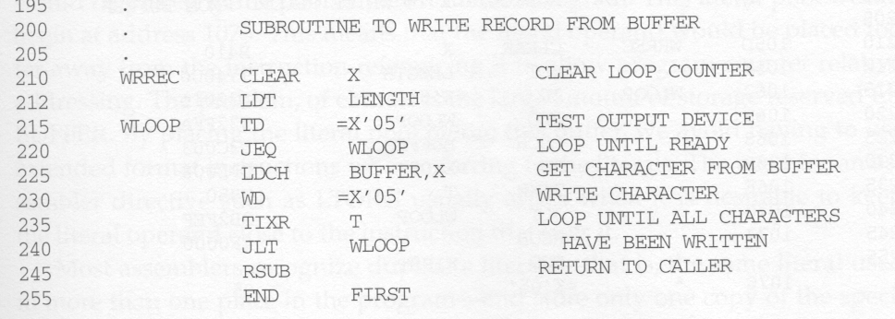
Literal Example (2)
Defines a 1-byte literal with hexadecimal value 05

Slide 7
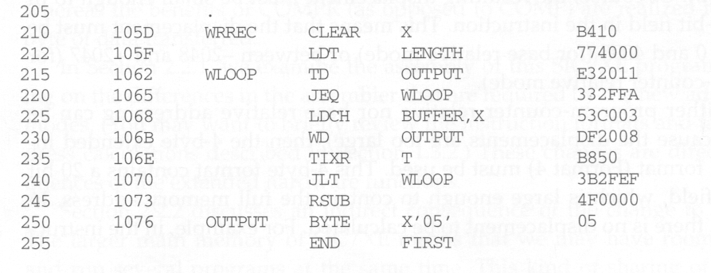
Original Program (2)

Slide 8
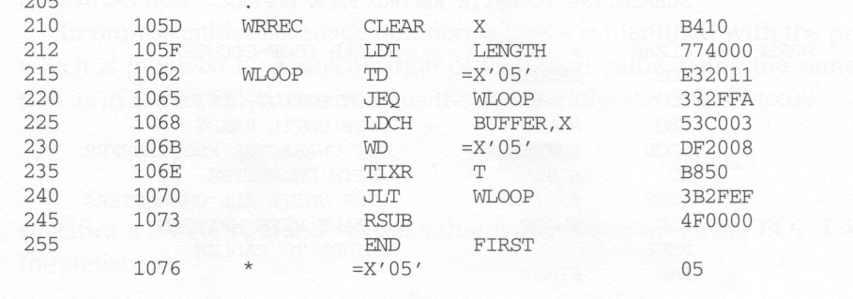
Literal Program (2)’s Object Code
Notice that the object code is the same as the previous one.

Slide 9
Difference between Literal and Immediate Operand
Immediate addressing
  The operand value is assembled as part of the machine instruction.
Literal
  The assembler generates the specified value as a constant at some other memory location.
  The address of this generated constant is used as the target address for the machine instruction.
  The effect of using a literal is exactly the same as if the programmer had defined the constant explicitly and used the label assigned to the constant as the instruction operand.

Slide 10
Literal Pool
All of the literal operands used in the program are gathered together into one or more literal pools.
Normally literals are placed into a pool at the end of the program.
Literal pool shows listing of literals with the assigned addresses and generated data values.
Sometimes, it is desirable to place literals into a pool at some other location in the object program.
  LTORG assembler directive is introduced for this purpose. (line no. 93)
  When the assembler encounters a LTORG, it creates a pool that contains all of the literals used since the previous LTORG(or the beginning of the program).

Slide 11
LTORG Example
If we do not use a LTORG on line 93, the literal =C’EOF’ will be placed at the end of the program.
This pool begin at address 1073 and be too far away from the instruction that uses it. PC-relative addressing mode cannot be used.
LTORG is used when we want to keep the literal operands close to the instruction that uses it.

Slide 12
Duplicate Literals
Duplicate literals – the same literal used in more than one place in the program
For duplicate literals, we should store only one copy of the specified data value to save space.
Most assembler can recognize duplicate literals.
  E.g., There are two uses of =X’05’ on lines 215 and 230 respectively.
  However, just one copy is generated on line 1076.

Slide 13
Recognize Duplicate Literals
Comparing the character string defining them
  For example, =X’05’ and =X’05’
Comparing the generated data value
  For example, =C’EOF’ and =X’454F46’
  More intelligent
  However, usually the benefit is not great enough to justify the added complexity.

Slide 14
The Problem with String-Defining Literals
We should be careful about the literal whose value depends on their locations in the program.
E.g., ( * - current value of the location counter)
Suppose literals refer the current value of location counter
BASE *
LDB =*
If * appears on line 13, it would specify 0003. If it appears on line 55, it would specify an operand with value 0020.
Literal operands have identical names, but different values.

Slide 15
Literal Processing (1)
Need a data structure, literal table LITTAB. For each literal used, the table contains:
  Literal name
  The operand value and length
  The address assigned to the operand when it is placed in a literal pool.
  Organized as a hash table, using literal name or value as a key.

Slide 16
Literal Processing (2)
Pass 1:
  When encountering an literal, try to find it in LITTAB. If it can be found, do nothing.
  Otherwise, the literal is added to the LITTAB
    Name, operand value and length can be entered now
    Only the address field is left blank.
  When encountering a LTORG or the END,
    the assembler makes a scan of LITTAB.
    each literal currently in this table is assigned an address.
    The location counter is updated to reflect the number of bytes occupied by each literal.

Slide 17
Literal Processing (3)
Pass 2:
  For each literal operand encountered, search it in LITTAB and find its assigned address.
  The data values specified by the literals in each literal pool are inserted at the appropriate places in the object program exactly as if these values had been generated by BYTE or WORD statements.
  If a literal represents an address in the program (e.g., a location counter value), the assembler must also generate the Modification record.

Slide 18
Symbols
We can use the EQU assembler directive to define a symbol and its value.
  So far, the only symbols defined in a program are labels, whose values are the addresses assigned to them.
  General form:- symbol EQU value
  Defines the given symbol, enter it into symbol table and assign to it the value specified.
  e.g., MAXLEN EQU 4096.
The value assigned to a symbol may be a constant, or any expression involving constants and previously defined symbols.

Slide 19
Usages of Symbols (1)
Use symbolic names to improve readability in place of numeric values.
  E.g., +LDT #4096 (on line 133)
  - Load value 4096 into register T.
  4096 - the max. length of a record.
  can be changed to :
  MAXLEN EQU 4096
When the assembler encounters the EQU statement, it enters MAXLEN into SYMTAB (with value 4096).
During assembly of the LDT instruction, the assembler searches SYMTAB for the symbol MAXLEN, using its value as the operand in the instruction
+LDT #MAXLEN

Slide 20
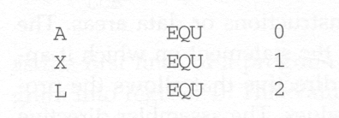
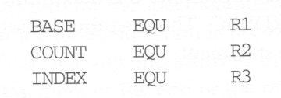
Usages of Symbols (2)
Define mnemonic names for registers:
(1)
(2)

Slide 21
ORG Directive
This can be used to indirectly assign values to symbols.
General format:- ORG value
When this statement is encountered during assembly of a program, the assembler resets its location counter (LOCCTR) to the specified value.
Since the values of the symbols used as labels are taken from LOCCTR, the ORG statement will affect the values of all labels defined until the next ORG.
Normally, when an ORG without specified value is encountered, the previously saved location counter value is restored.

Slide 22
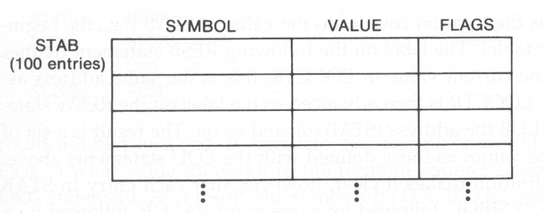
ORG Usage Example
Suppose that we have the following data structure and want to access its fields:
6-byte
3-byte
2-byte

Slide 23

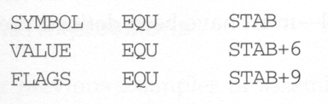
Program without Using ORG
Reserve space for this table
Show offsets, less
readable
We can then use LDA VALUE, X to fetch the VALUE
field from the table entry indicated by the content of
register X.
To fetch the next record, X is added by 6 + 1 + 2.

Slide 24
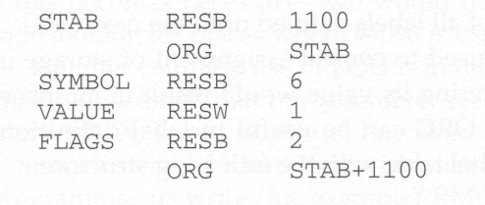
Program with Using ORG
Reset LOCCTR to the value of STAB
Show sizes, more
readable
Restore the location counter to
the old value

Slide 25

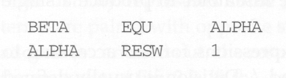
No Forward Reference Allowed
For EQU and ORG, all symbols used on the right hand side of the statement must have been defined previously in the program.
This is because in the two-pass assembler, we require that all symbols must be defined in pass 1.
Allowed
Not allowed
BETA cannot be assigned a value during pass1

Slide 26
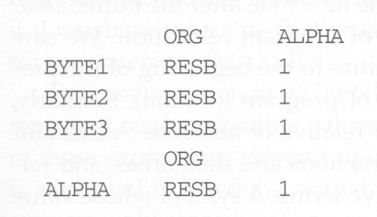
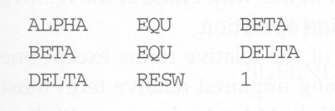
ORG Restriction
Not allowed
Not allowed

Slide 27
Expression
So far, the assembler statements used single terms (labels, literals, etc.) as instruction operand.
We can also use expressions which contain many terms to define a symbol’s value.
  - E.g., 107 MAXLEN EQU BUFEND - BUFFER
Individual terms in the expression – constants, user defined symbols or special terms.
Most common special term – current value of location counter (represented by *) – value of the next unassigned memory location.
  - E.g., 106 BUFEND EQU *
  gives BUFEND a value that is the address of the next byte after the buffer area.

Slide 28
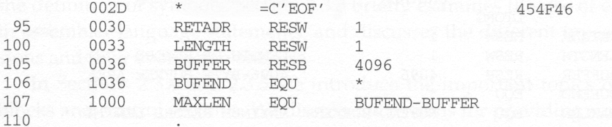
Expression

Slide 29
Relative v.s. Absolute Value
Generally, +, -, *, /, operations are allowed to be used in an expression.
Division is defined to produce an integer.
Regarding program relocation, a symbol’s value can be classified as
  Relative
    Its value is relative to the beginning of the object program, and thus its value is dependent of program location.
    E.g., labels or reference to location counter (*)
  Absolute
    Its value is independent of program location
    E.g., a constant.

Slide 30
Relative v.s. Absolute Expression
Depending on the type of value they produce, expressions are classified as:
  Absolute
    An expression that contains only absolute terms, or
    An expression that contains relative terms but the relative terms occur in pairs and the terms in each pair have opposite signs. (/ and * operations are not allowed on relative terms)
  Relative
    An expression in which all relative terms except one can be paired and the remaining unpaired term must have a positive sign. (/ and * operations are not allowed)

Slide 31
Absolute Expression Example
107 MAXLEN EQU BUFEND – BUFFER
Although BUFEND and BUFFER are relative terms (because their values will change when the program is loaded into a different place in memory), the expression (BUFEND – BUFFER) is an absolute expression.
Why? the value of this expression is 0x1000, which is the same no matter where this program is loaded.
Why? Because BUFEND and BUFFER can be represented as (startingaddr + x) and (startingaddr + y), BUFEND – BUFFER becomes (x – y), which is a constant.

Slide 32
Illegal Expressions
BUFEND + BUFFER
100 – BUFFER
3 * BUFFER
These expressions represent neither absolute nor location within the program
Therefore, these expression are considered illegal.

Slide 33
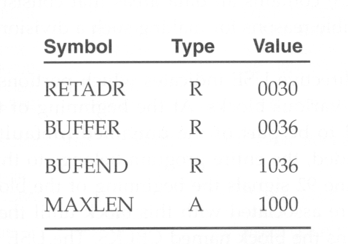
Enhanced Symbol Table
To determine the type of an expression, we must keep track of the types of all symbols defined in the program,
Therefore, we need a flag in the symbol table to indicate type of value (absolute or relative) in addition to the value itself.

